Slide 1
Secure Banking System using
Blockchain Technology
Capstone Project
Review -3
Team -25

Slide 2
Project Title : Secure Banking System using Blockchain Technology
Guide : Dr Praveen Lalwani
Members :
18BCY10034 | Fardeen Ahmed
18BCY10010 | Akshat Nigam
18BCY10093 | Shreyansh Saxena
18BCY10012 | Alkesh Gupta

Slide 3
Proposed Work
We aim to develop a web-based serverless application which works on a decentralized system for handling transactions between users ruling out the utilization of any centralized database.
All the transactions are to be verified by smart contract and stored in the Near Blockchain. The application will be built on the top of a cloud-based infrastructure which will be a community-operated cloud instead of a company-operated cloud.
Appropriate additional level of security measures will be implemented for the user authentication before any transactions occurs.

Slide 4
Software Requirements
Frameworks
React
Material UI
NEAR Blockchain
Languages
JavaScript
HTML & CSS
AssemblyScript
IDE
VS Code

Slide 5
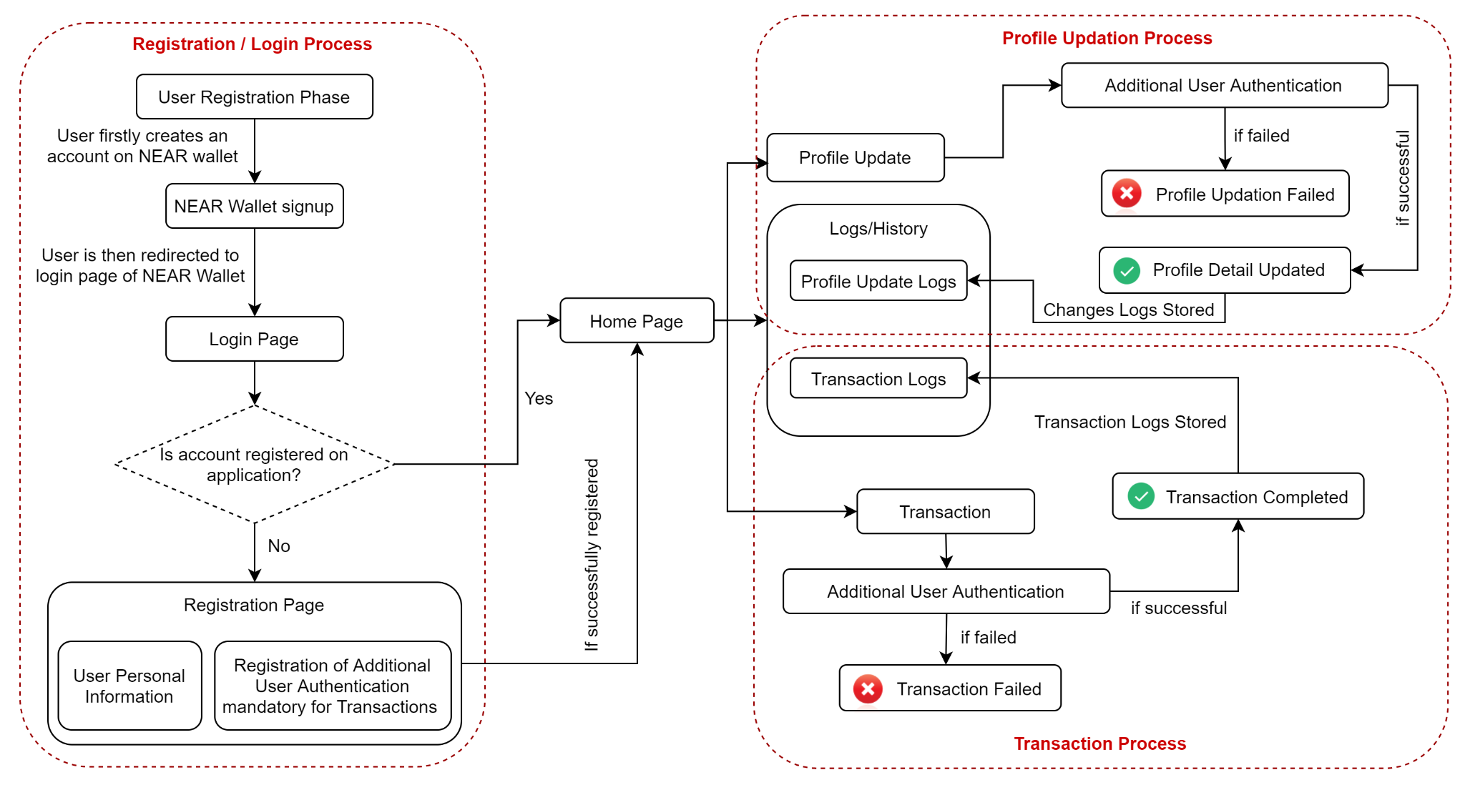
Overall System Architecture Diagram

Slide 6
Modules & Explanation
01. Authentication Module : User Registration & Login Process will be implemented under this module using NEAR wallet authentication.
02. Profile Details Module : Basic user details such as mobile, email, etc will be handled under this module.
03. Transaction Module : Money Transaction process between user accounts will be implemented.
04. Logs & History Module : Profile modification & transaction history will be managed under this module.
05. Additional Authentication Module : Second level authentication, for transaction purpose & profile updation, will be implemented in this module.

Slide 7
Work Completed Till Date
01. Registration of User Account.
01.1 Application Connection with NEAR Wallet.
01.2 User Account Creation on the Application.
02. Transaction Between Accounts.
02.1 Transferring NEAR Token from one Account to another.
02.1.1 Taking affirmative action from User through Passphrase.
02.2 Storing the transaction logs at both the User Ends.
03. Implemented Recent User’s Transactions History.
(Contd.)

Slide 8
Work Completed Till Date
04. Money Request Feature
04.1 Requesting Money from another user
04.2 Notifying User for New Money Requests
04.3 Approving Requested Money Transfer
05. Money Transfer through QR (Fast Payment)
05.1 Sending Money through QR Code Scanning
05.2 Receiving Money through QR Code Generation
06. User’s Complete Transactions

Slide 9
Anticipated Work To Be Done
01. User Interface Improvements
02. Finalization & Documentation

Slide 10
THANK YOU

